Slide 1
TOPIC: SENTIMENT ANALYSIS OF COVID-19 TWEETS
Team name : PUVI
Team Member : Vikash kumar & puja kumari

Slide 2
INTRODUCTION
We all are aware that how COVID-19 (Coronavirus) impact on many people.
This is the biggest pandemic of 2020 worldwide.
Many people are getting affect by the emotional stability.
So to analyse people sentiment we chose this topic so that people can easily come out with there emotions.
To understand and analyze the human sentiments publicly we choose twitter API because twitter is the biggest source of social media where people share a lot of views.

Slide 3
UNIQUENESS
We are considering the live tweets instead of some particular period tweets.
It will analyze the government profile tweet every time and all those tweets will be analyzed based on polarity and emojis.
This project will be easily accessible as it will deploy on the cloud and from every device, it will be accessible. This project dashboard will be user responsive.
This means the design of our project is similar to adaptive design, which also adapts to the different screen sizes such as we can see that project on mobile phones, laptops, and tablets.

Slide 4
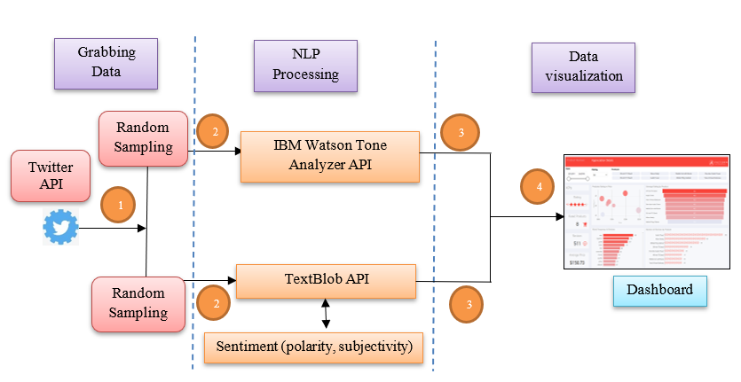
Idea behind our project

Slide 5
Steps involve
Step 1: Tweets Collection
Step 2: Data Pre-processing i.e. Tweets
Step 3: Analysing the Data through NLP
Step 4: Finally Dashboard Design

Slide 6
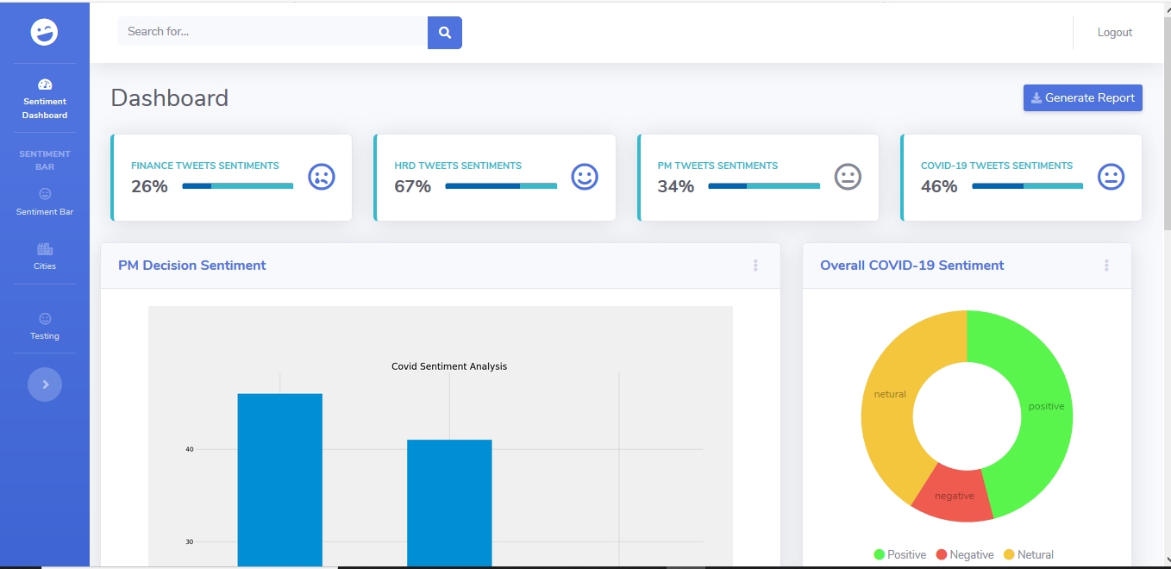
Snapshot of our project
Here we are going to show how our dashboard look like and how we are able to analyse. Here we are showing the tweets sentiments in the form of graph donut, percentage and word cloud.

Slide 7
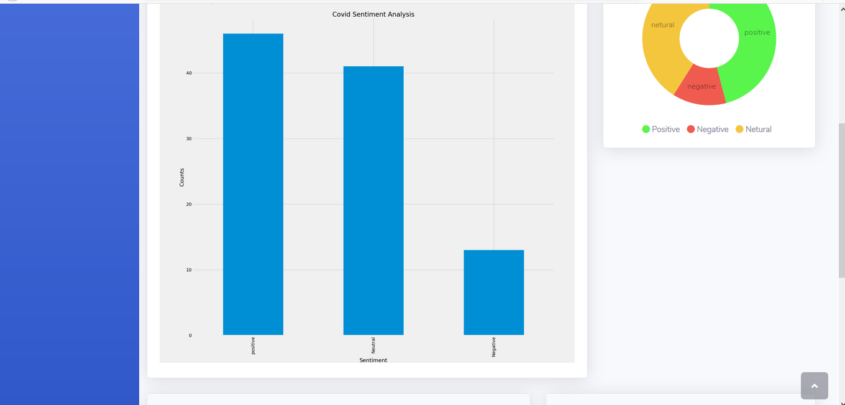
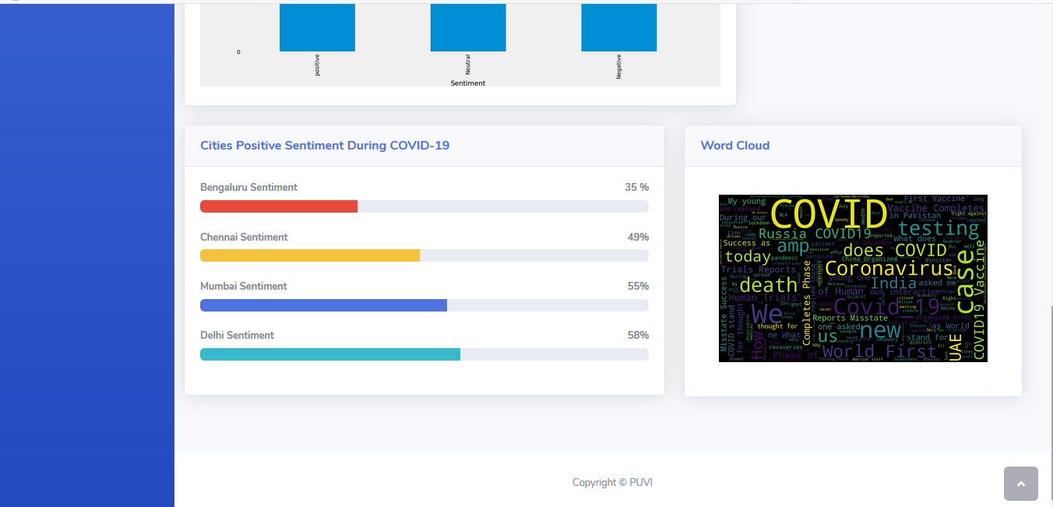
Continued………

Slide 8
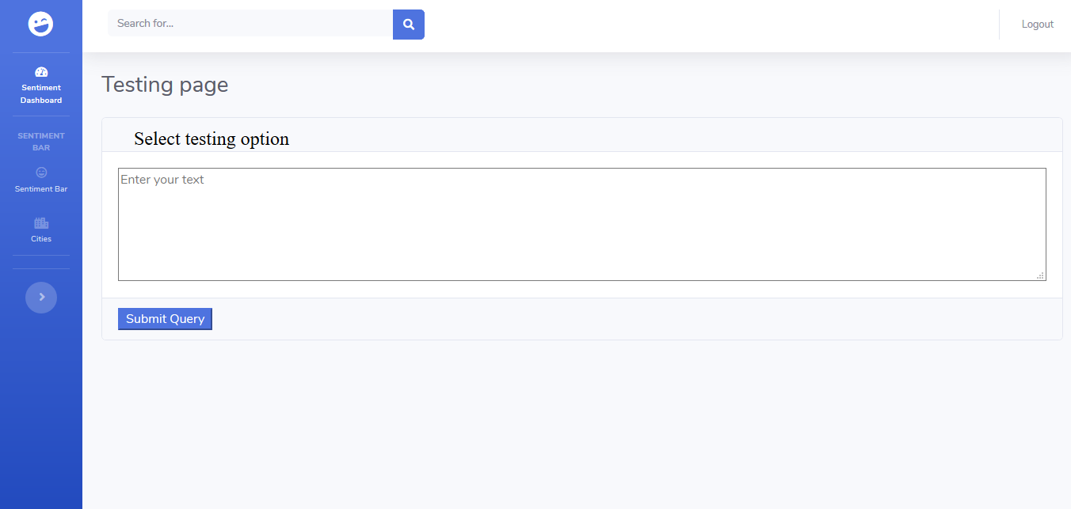
TESTING
This is testing page where we are going to analyse the emotions or sentiments on a particular tweets or text.

Slide 9
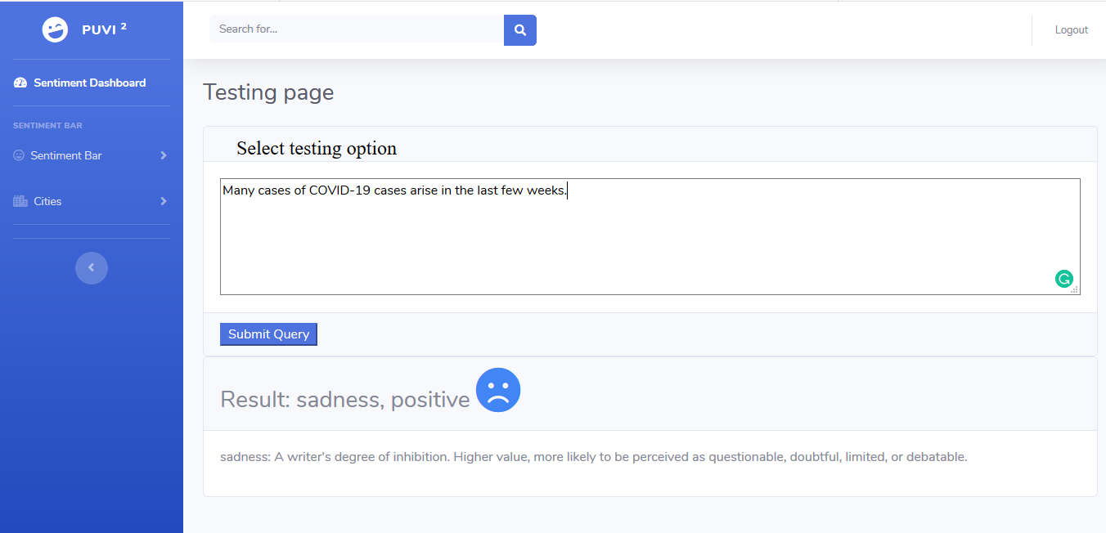
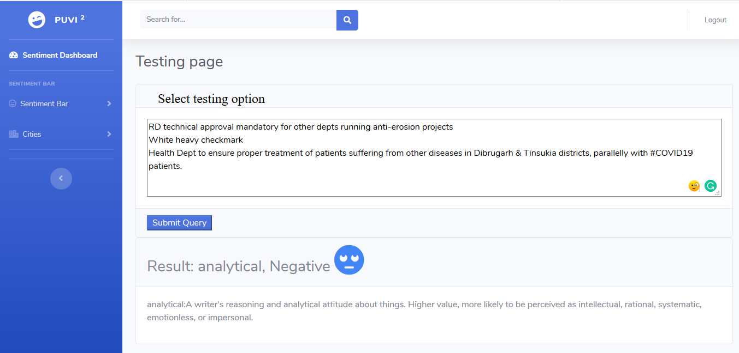
Output
Here in output I am going to show to the analysis done.

Slide 10
conclusion
In this project, we analyzed the sentiments of COVID-19-related tweets in several ways. The overall trend shows that the public has been more optimistic over me. Digging into the multi-dimensional sentiment analysis, we found that the sentiment “Assertive” went up, and “Fearful” went down through the me. Besides, the Sentiment Density indicates that the public turned out to be less loaded with emotions. At last, the topics behind the sentiments unfolded more details.

Slide 11
Future scope
Future research can be done with possible improvement such as more refined data and more accurate algorithm.
Potential improvement can be made to our data collection analysis method.
In future we can also do the best to analyze the other language tweets with English tweets.
We can also make use of BERT Classification for analyzing the tweets

Slide 12
THANKYOU
STAY SAFE….

